Slide 1

A long video caption generation algorithm for big video data retrieval
Songtao Ding, Shiru Qu, Yuling Xi, Shaohua Wan, 2018
Presented By:
Zahra Moosavi Movahed 810196629
Amir Mohammad Ranjbar Pazoki 810199340

Slide 2
Introduction to problem
Long Video
Extract key frames
Caption Generation
Application:
Video data retrieval
Automatic driving
Visual impaired people self-care
Video surveillance

Slide 3
Key parts of problem
Identification of interesting segments
Automatic selection of video key frames
Image caption Generation

Slide 4
Previous works
Key frames selection
Frames with higher contrast, sharpness and color
Emphasis on objects, people and facial information
Natural language generation system
Statistical information collected from the analysis on large amount of text data and recognition algorithms
Image titles on web
LSTM units and a deep recurrent generation model

Slide 5
In this paper…
Detect and remove redundant frames -> STIP
Long video segmentation -> Non-linear combination of visual features
Key-frame selection -> Region of interest by STIP, Selecting by saliency detection
Generating caption -> LSTM variant combined with attention mechanism

Slide 6
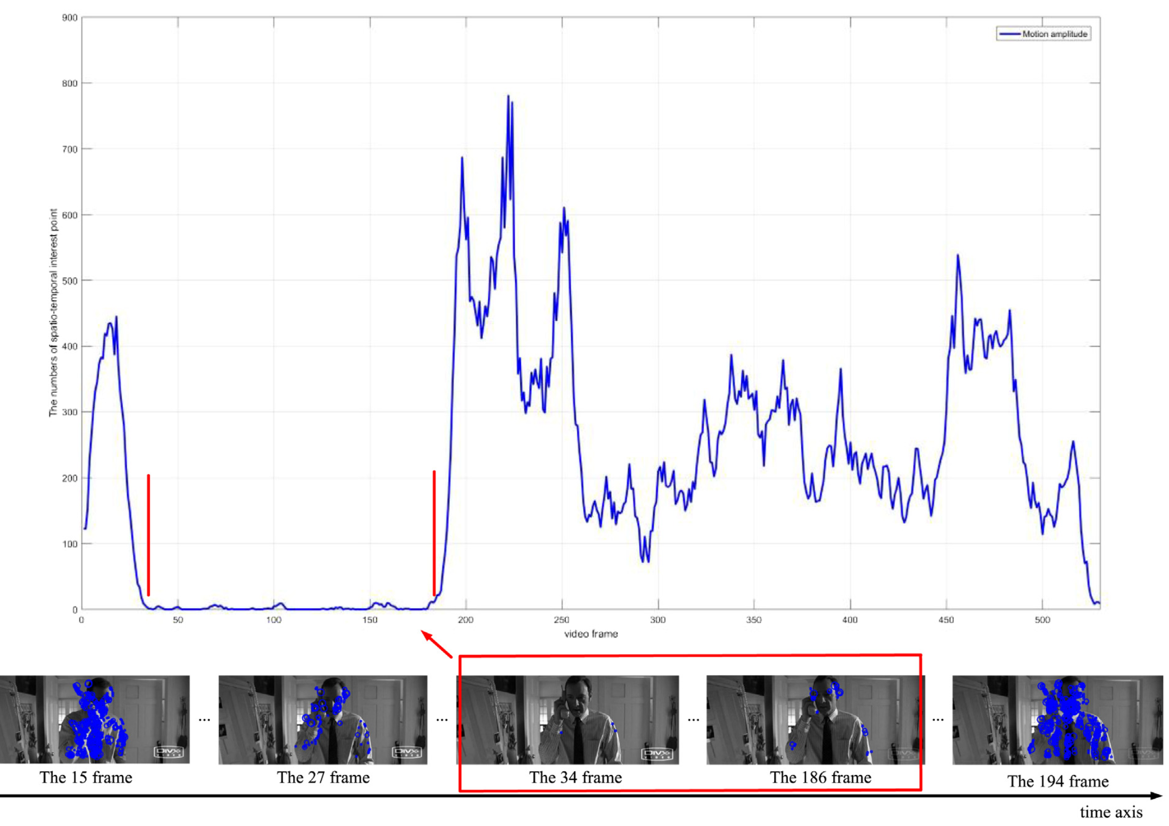
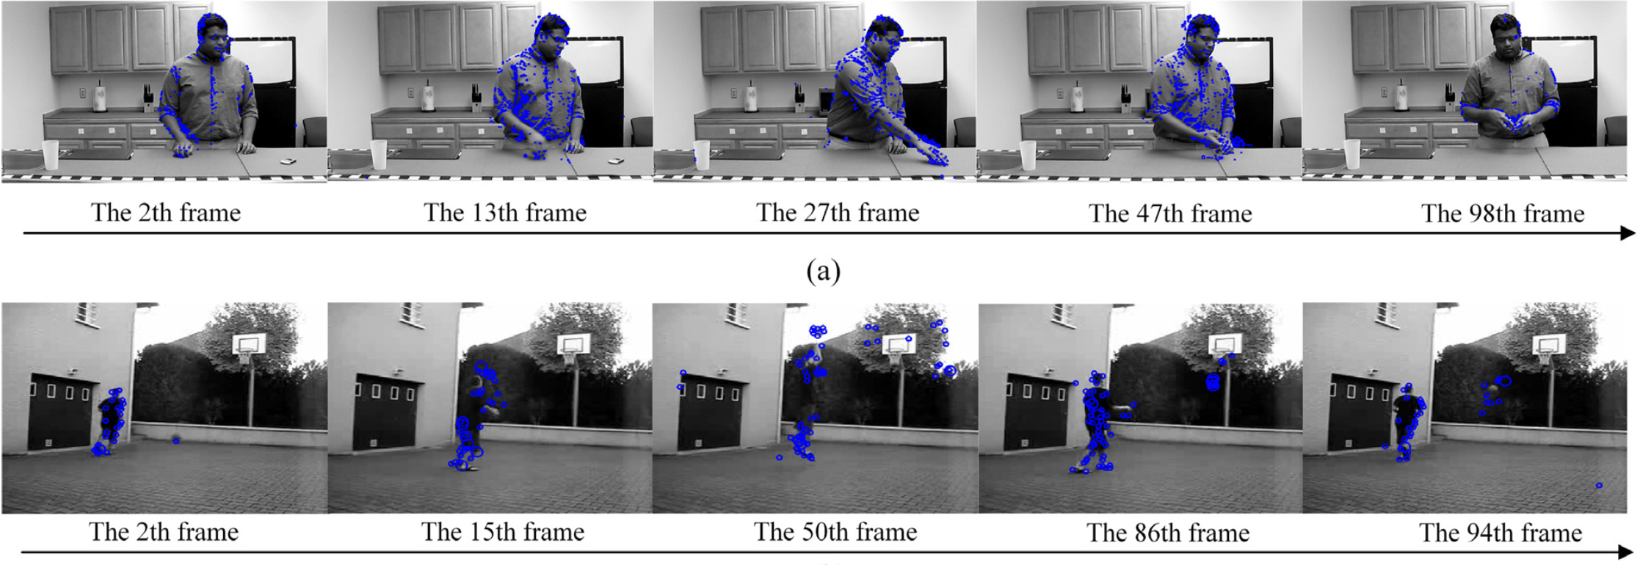
STIP (Spatio-temporal interest point) detector for redundant video frame detection
Perfomance of STIP Detector
Detection of change in long video

Slide 7

Video frame segmentation
Features
Attention (A)
Contrast (C)
Sharpness (E)
Colorfulness (S)
Facial Impact (F)
$$I_{score}=A × C × S × E × η(F)$$

Slide 8
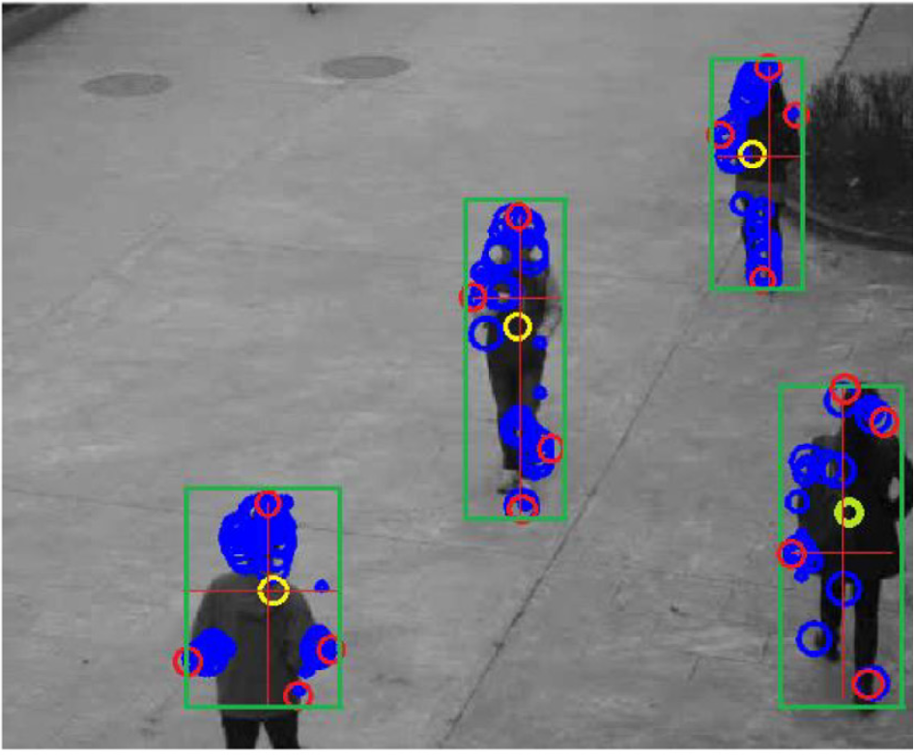
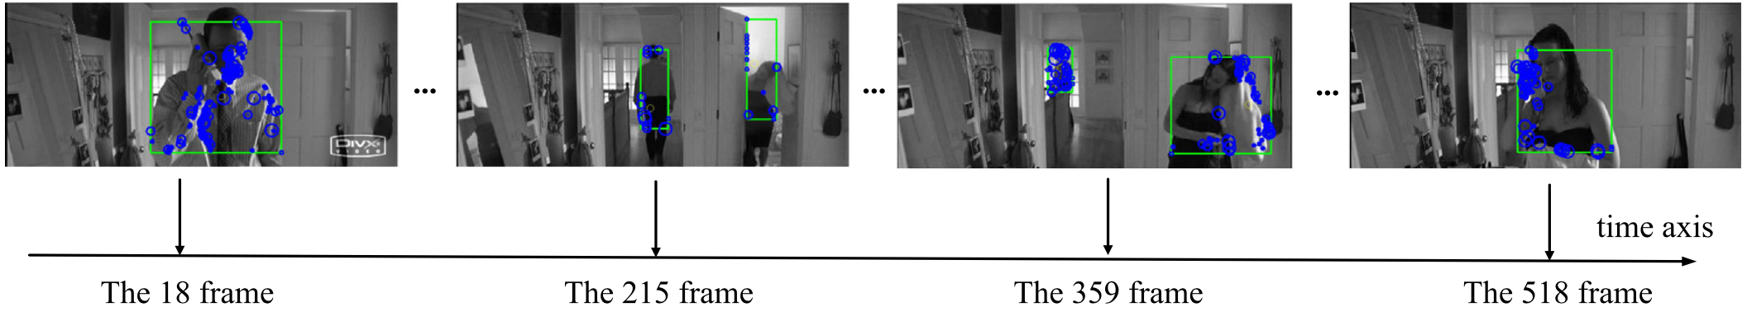
Key frame selection
Find Key frames by applying saliency detection
Region of interest by STIP

Slide 9
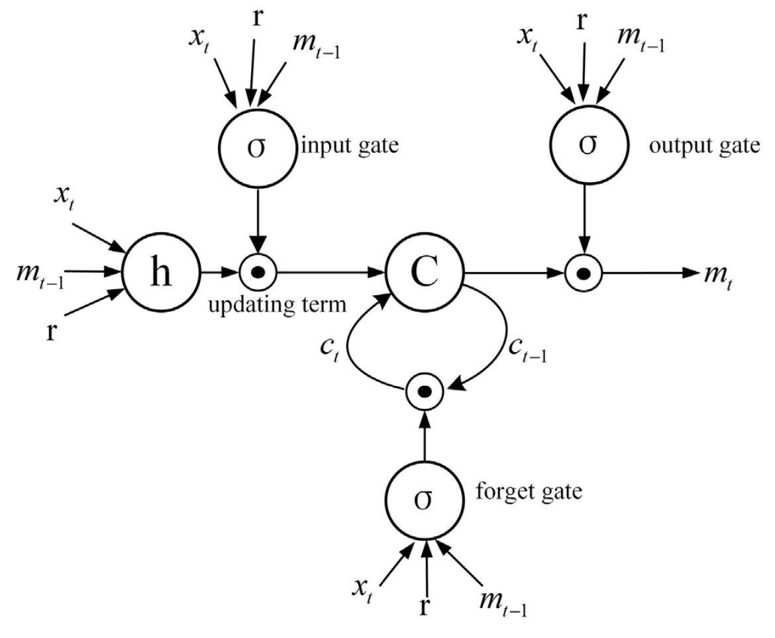
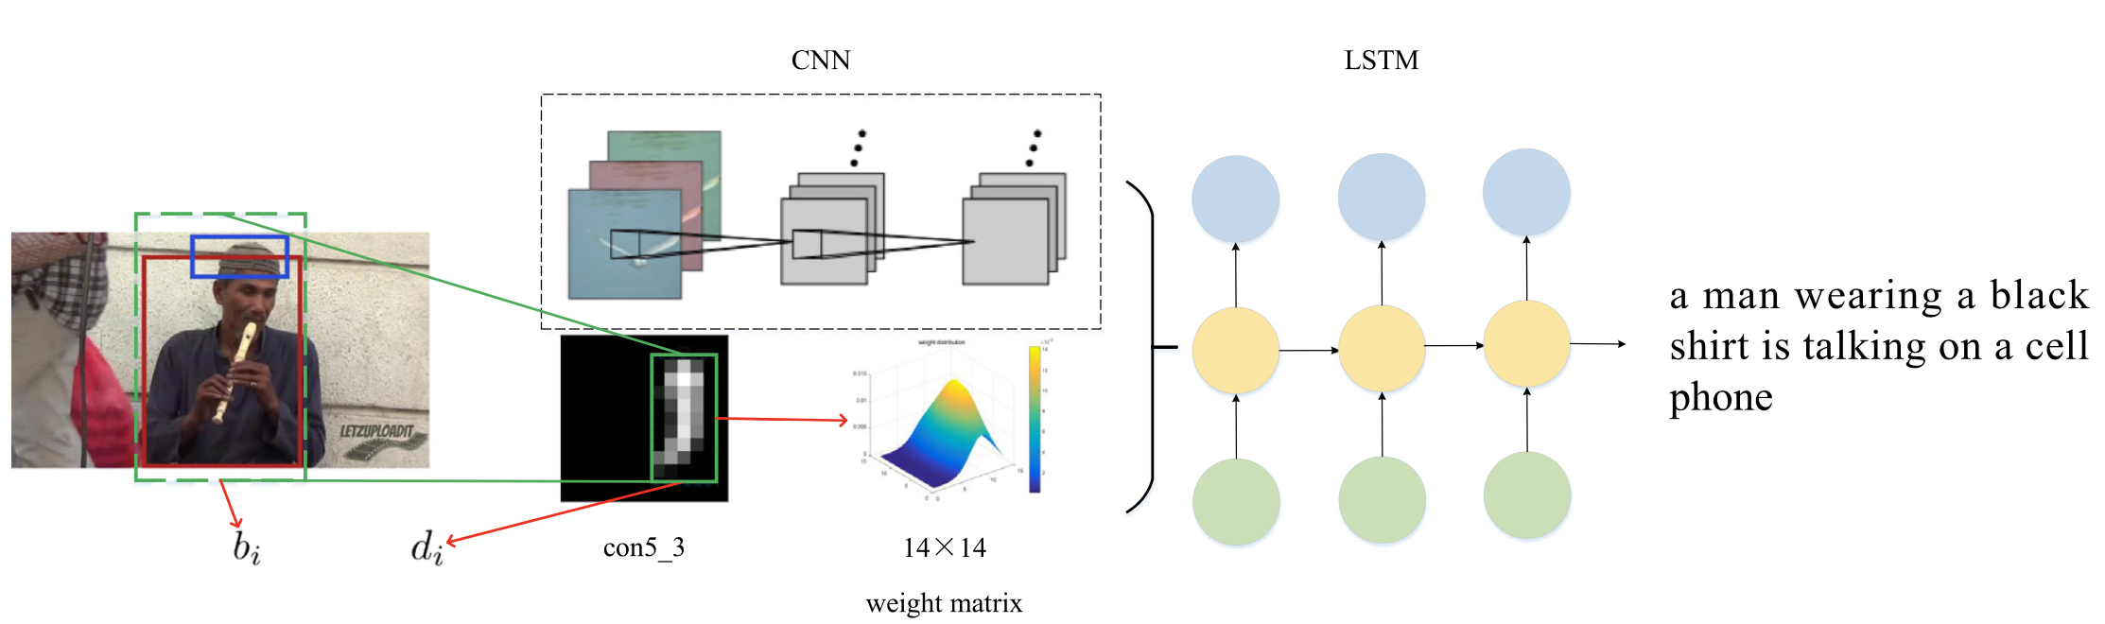
Caption generation
Caption generation overview
LSTM Model

Slide 10
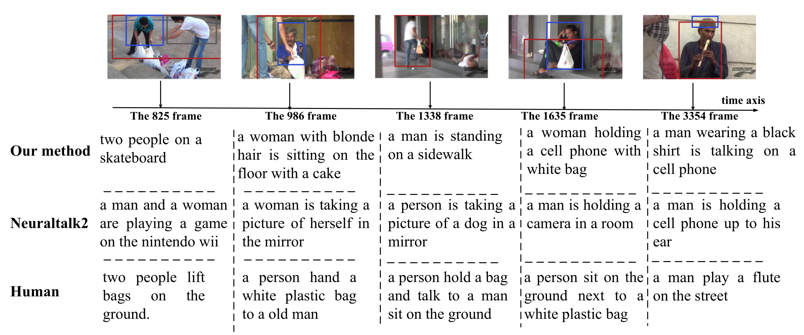
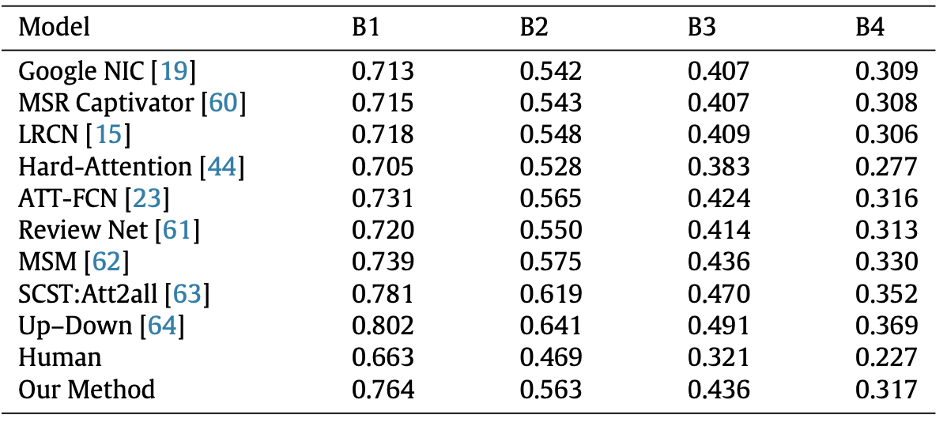
Results
Compare this method with others
Example of output

